Slide 1
DAILY DELHI CLIMATE
LINK : https://www.kaggle.com/datasets/sumanthvrao/daily-climate-time-series-data
DATASET : DailyDelhiClimate.csv

Slide 2
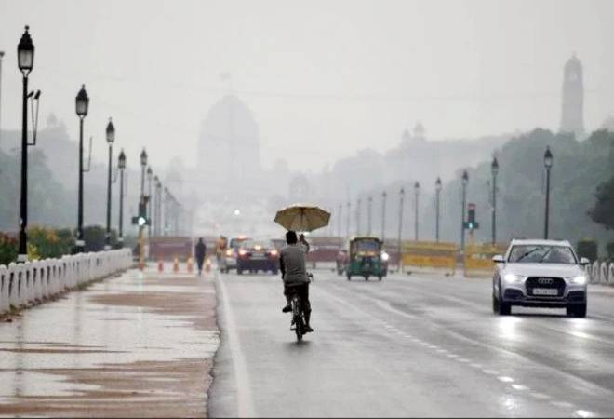
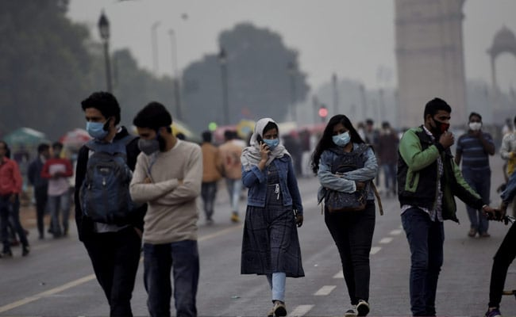
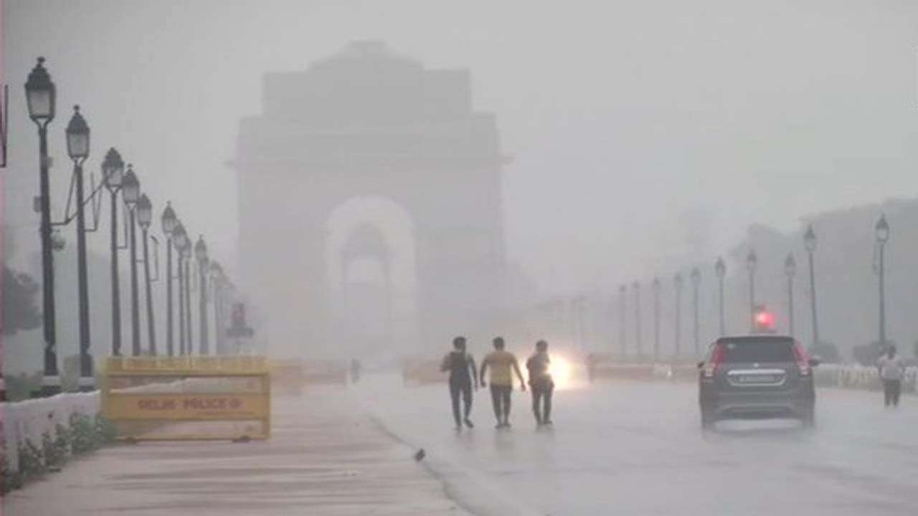
GOAL :
This dataset provides data from 1st January 2013 to 24th April 2017 in the city of Delhi, India. The 4 parameters here are meantemp, humidity, windspeed, mean pressure. This is in order for weather forecasting.
Acknowledgements
This dataset has been collected from Weather Underground API. Dataset ownership and credit goes to them.

Slide 3
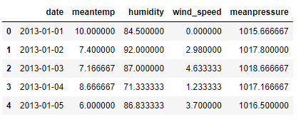
VARIABLES INVOLVED :
Date
Meantemp
Humidity
wind_speed
mean pressure

Slide 4
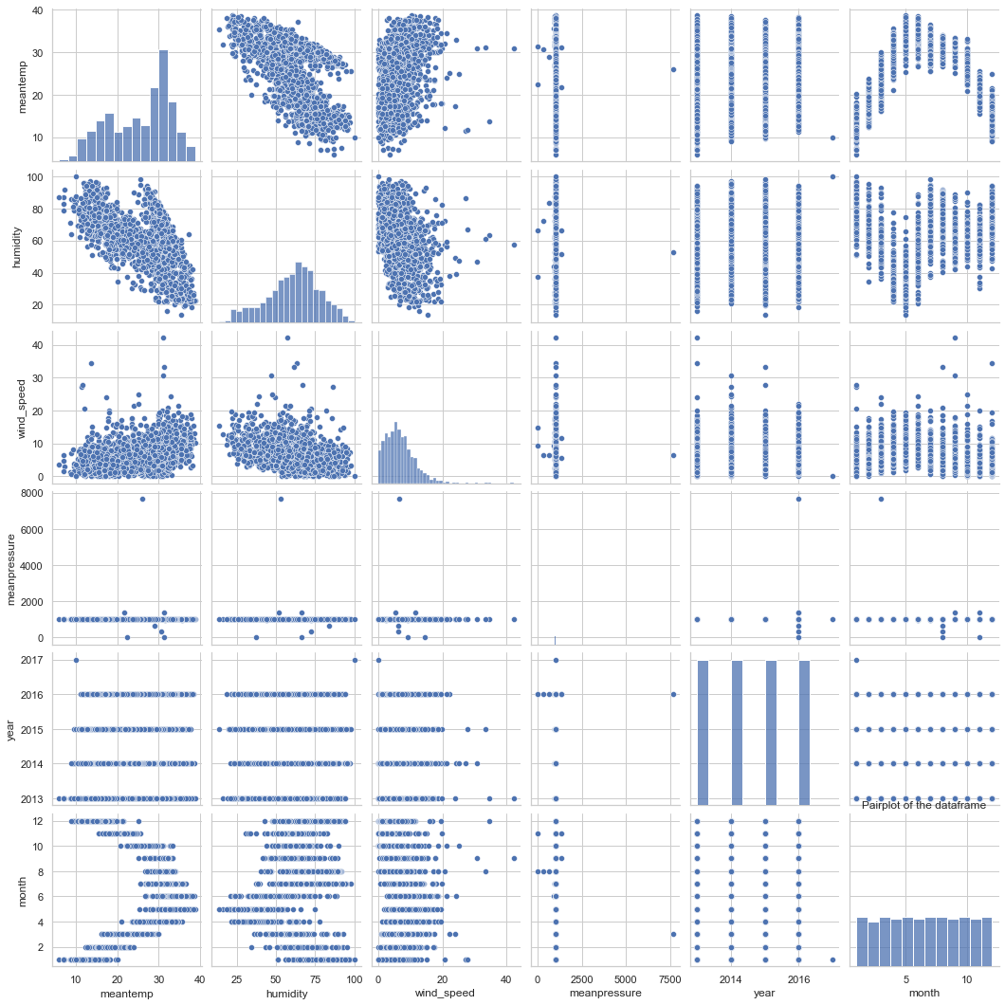
EDA :
Decomposition of Time Series :
Seasonality - does the data have a clear cyclical/periodic pattern?
Trend - does the data represent a general upward or downward slope?
Noise - what are the outliers or missing values that are not consistent with the rest of the data?
PAIRPLOT

Slide 5
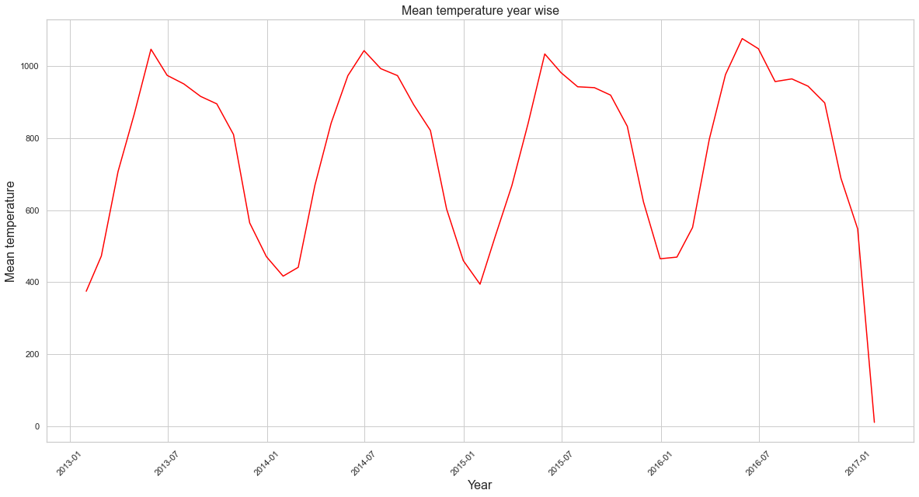
EDA :
MEAN TEMPERATURE YEAR WISE

Slide 6
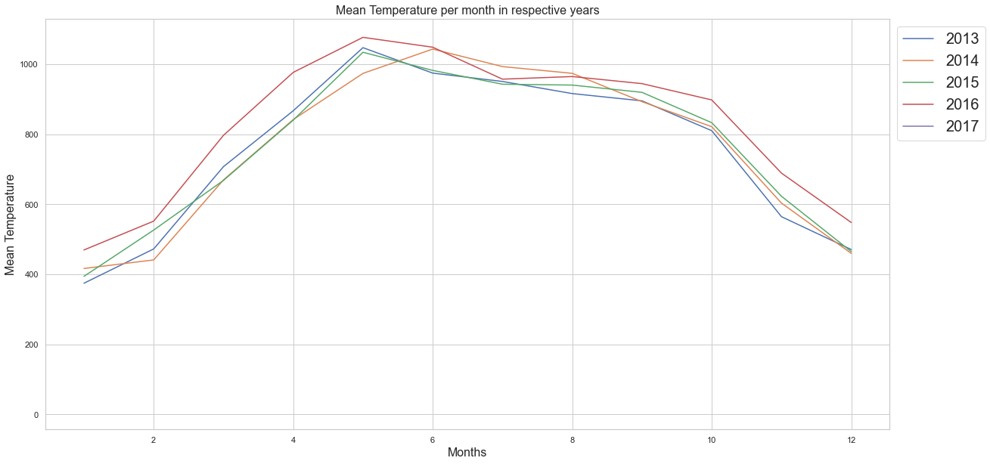
EDA :
MEAN TEMPERATURE PER MONTH IN RESPECTIVE YEARS

Slide 7
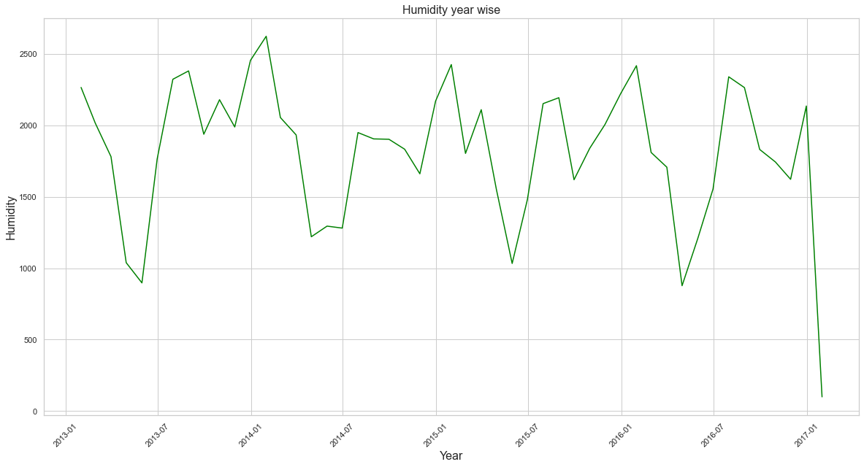
EDA :
HUMIDITY YEAR WISE

Slide 8
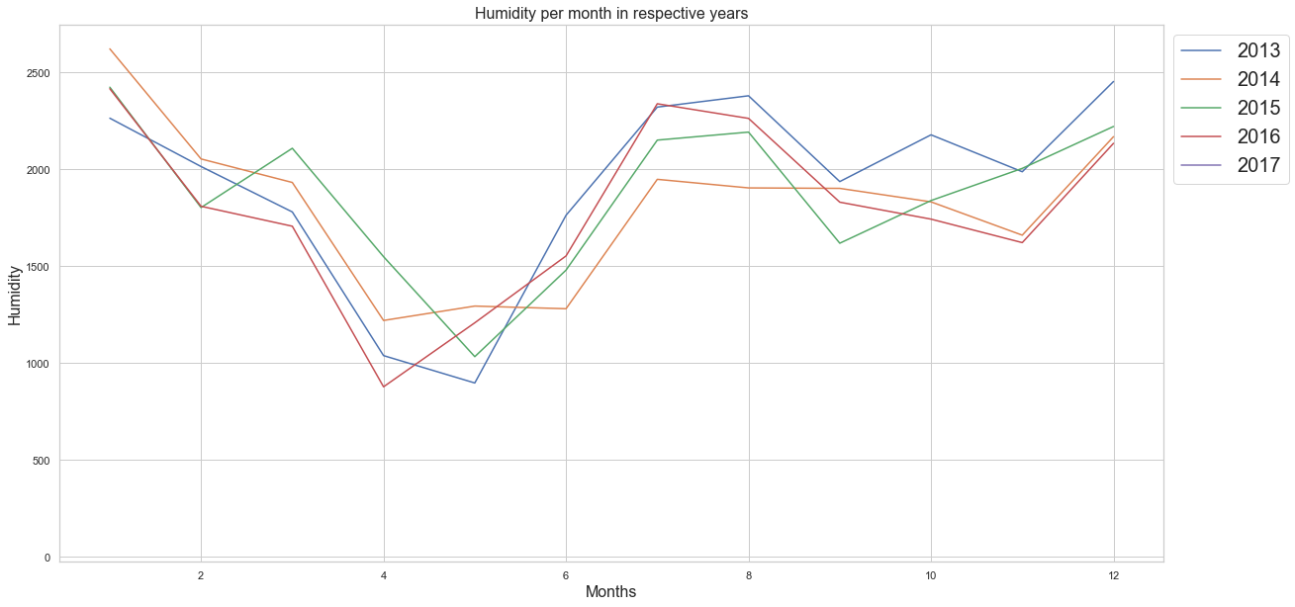
EDA :
HUMIDITY PER MONTH IN RESPECTIVE YEARS

Slide 9
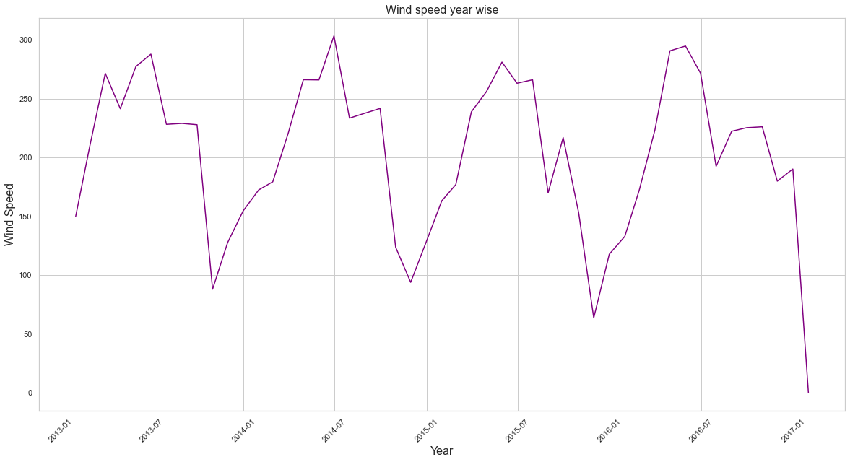
EDA :
WIND SPEED YEAR WISE

Slide 10
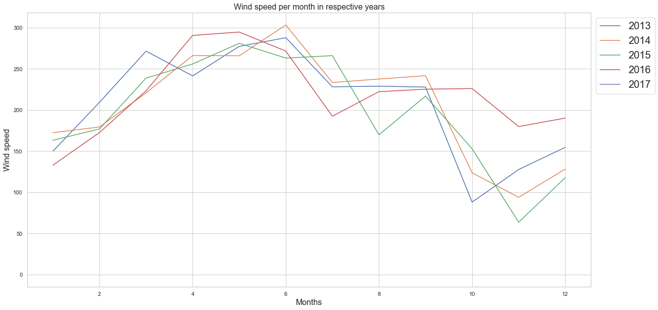
EDA :
WIND SPEED PER MONTH IN RESPECTIVE YEARS

Slide 11
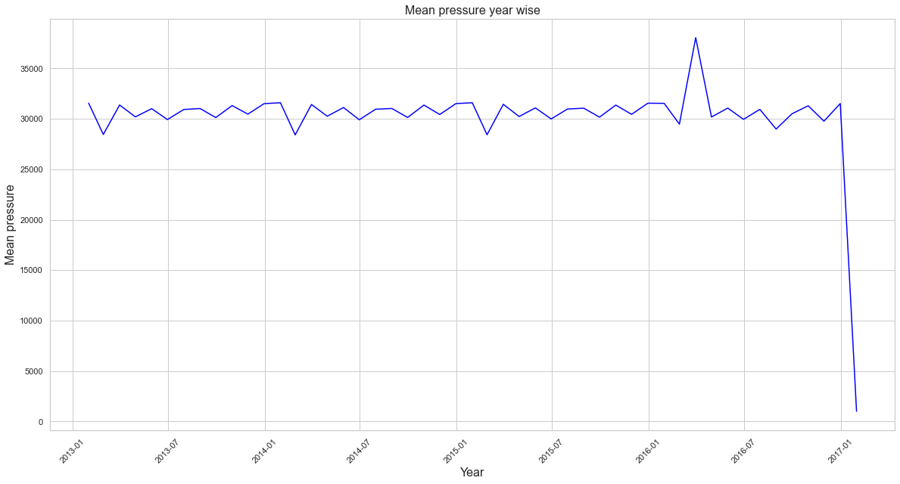
EDA :
MEAN PRESSURE YEAR WISE

Slide 12
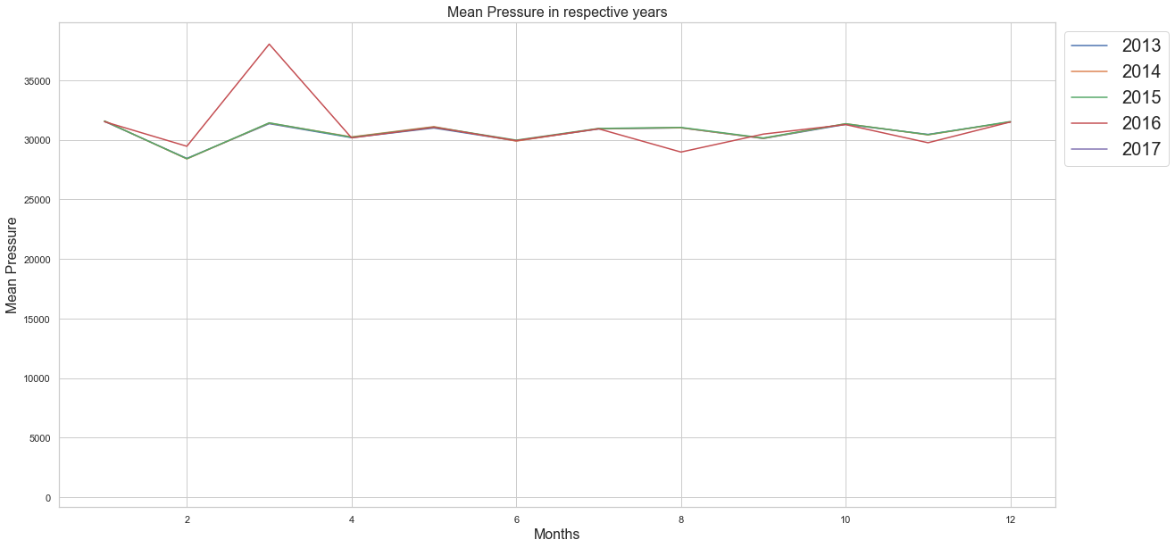
EDA :
MEAN PRESSURE IN RESPECTIVE YEARS

Slide 13
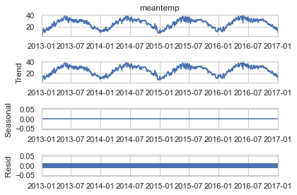
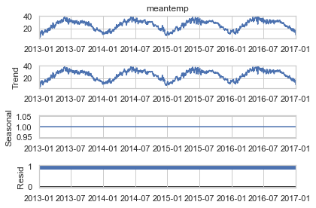
ADDITIVE & MULTIPLICATIVE MODELS :
MULTIPLICATIVE MODEL
ADDITIVE MODEL

Slide 14
TEST OF STATIONARITY :

Slide 15
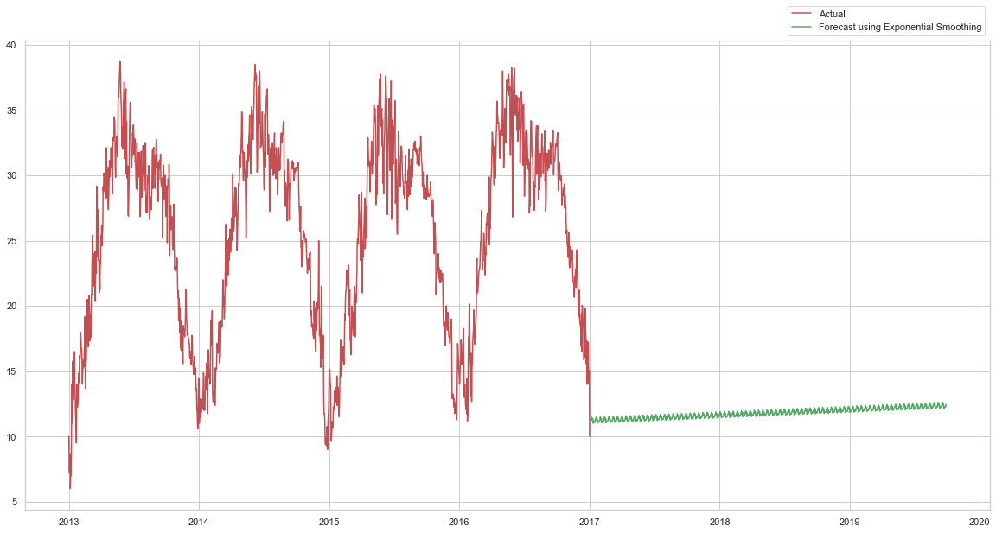
MODEL BUILDING :
Exponential Smoothing [Triple Smoothing ]
FORECASTING/PREDICTING
USING
EXPONENTIAL SMOOTHING
RMSE : 1.636

Slide 16
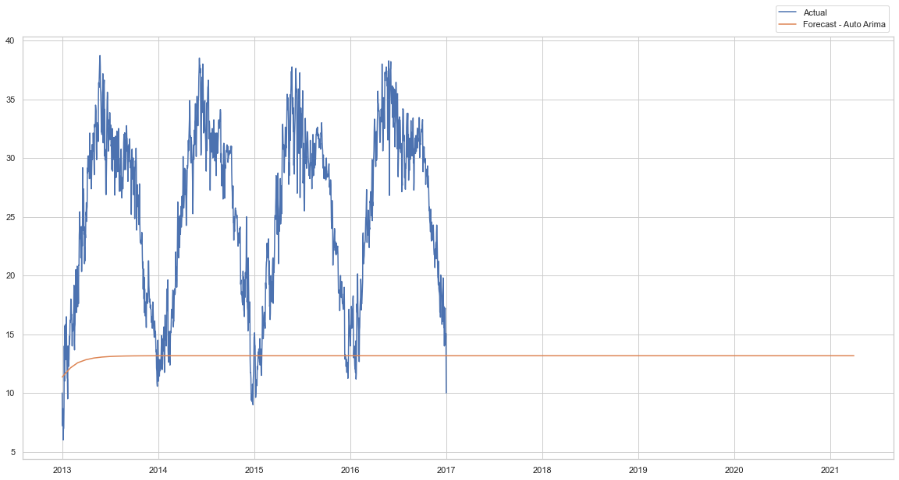
MODEL BUILDING :
AutoArima
FORECASTING/PREDICTING
USING
AUTOARIMA
RMSE : 1.629

Slide 17
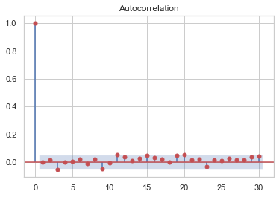
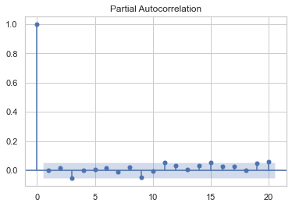
PACF & ACF PLOTS :

Slide 18

THANK YOU FOR VIEWING MY WORK!

